Slide 1

Lesson #1
Driving practice and hazard prediction.

Slide 2



learning intentions
personal safety
I am learning how to assess and manage risk and personal safety in a wide range of contexts.
when travelling
I am developing strategies to manage personal safety in relation to travel.
hazard awareness
I am learning to recognise what hazards on the road can be like and how I can manage them better.

Slide 3

group agreement
What ground rules or group agreement statements would we like for this lesson?

Slide 4



skills for driving activity
1
2 3
4 5 6
7 8 9 10
11 1 2 13
14 15
16
In your group, think about the skills needed to be able to drive a car safely and note them down.
Compare your list to the ‘skills for driving’ cards. What skills have come up already?
Rank the skills for driving cards using a diamond-16 formation.

Slide 5

identifying hazards
Draw and write about the hazards you are already aware of when driving or being a passenger.
Keep your answered covered until the end of this part of the lesson!

Slide 6
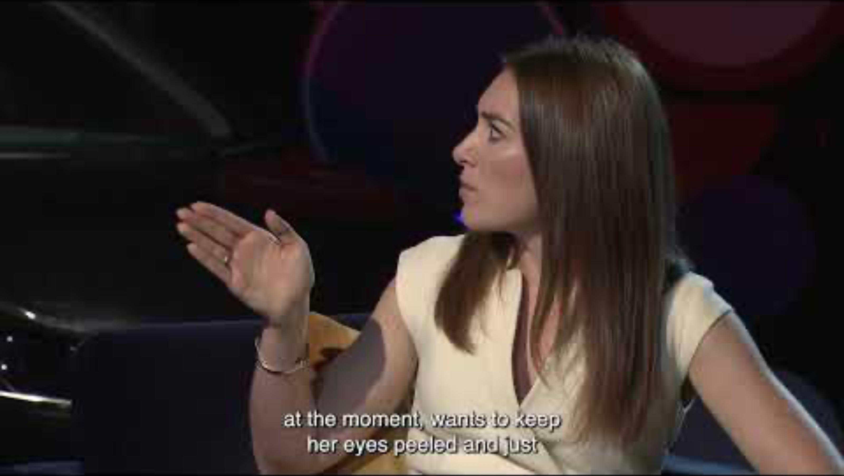
identifying hazards
https://www.youtube.com/watch?v=N59b55LQAq0

Slide 7
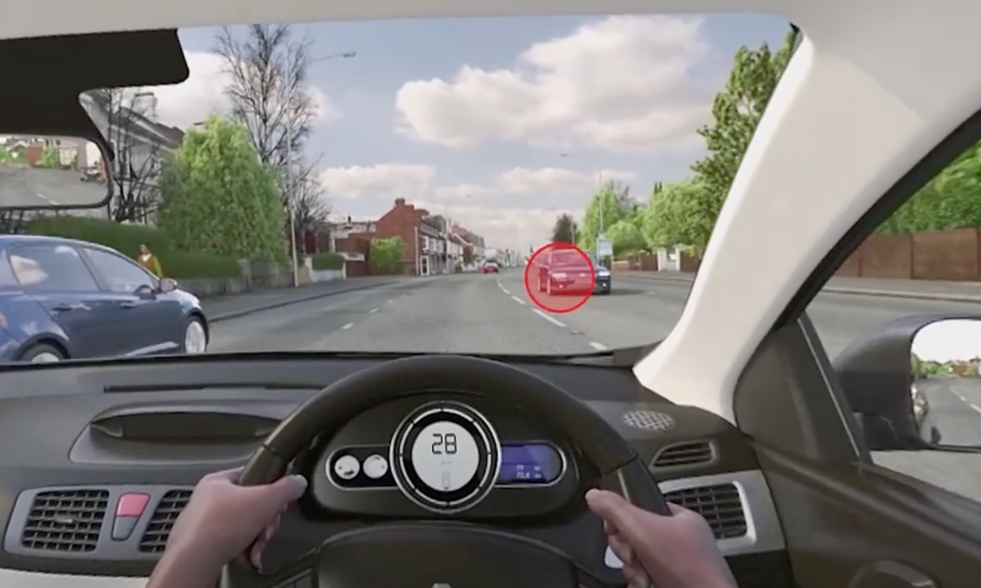

noticing hazards
In pairs, write on post-it notes all the hazards mentioned or noticed in the video.
Sort these hazards into categories/themes and share with another pair.
Collate all themes as a class.

Slide 8


internal & external
What can help our ability to perceive hazards?
Why is it important to take our time to learn to drive?
In pairs, discuss how hazards are noticed and how some hazards are missed: what internal and external factors might be involved, especially in a person’s ability to predict hazards?
How does experience enhance our skills in general?
What examples other than driving can you think of where experience and practice make such a positive difference?

Slide 9

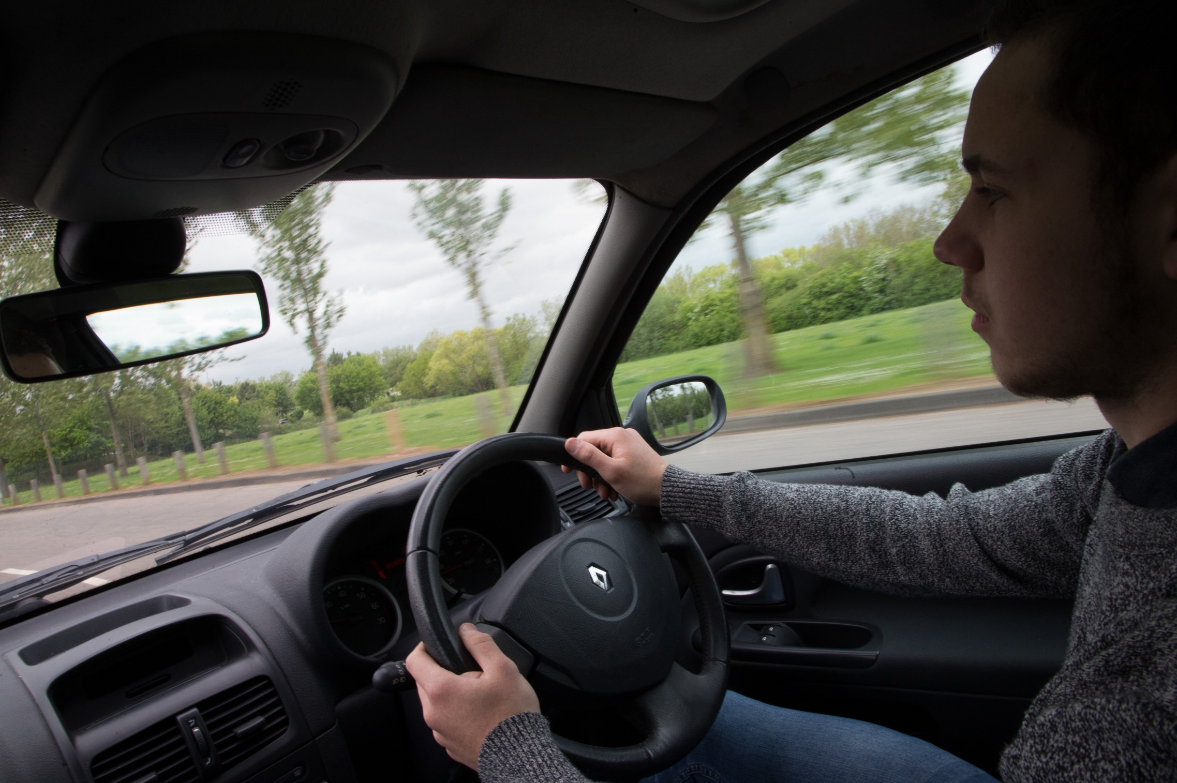

skills for driving
In pairs, pick out the skills that are needed when perceiving hazards.
    Are you already using these skills in your lives?
    What skills can be transferred to driving?

Slide 10
identifying hazards
Earlier you were asked to…
“Draw and write about the hazards you are already aware of when driving/being a passenger.”
Now, with another colour pen/pencil, add more or enhance existing hazards considering what has been discussed.

Slide 11
driving skills activity
1
2 3
4 5 6
7 8 9 10
11 12 13
14 15
16
Would you rearrange the ranking of the skills, considering what you have learnt in the lesson?

Slide 12
learning intentions
personal safety
I am learning how to assess and manage risk and personal safety in a wide range of contexts.
when travelling
Have these been met?
Next steps - what would you like to develop or learn about in the future?
I am developing strategies to manage personal safety in relation to travel.
hazard awareness
I am learning to recognise what hazards on the road can be like and how I can manage them better.

Slide 13
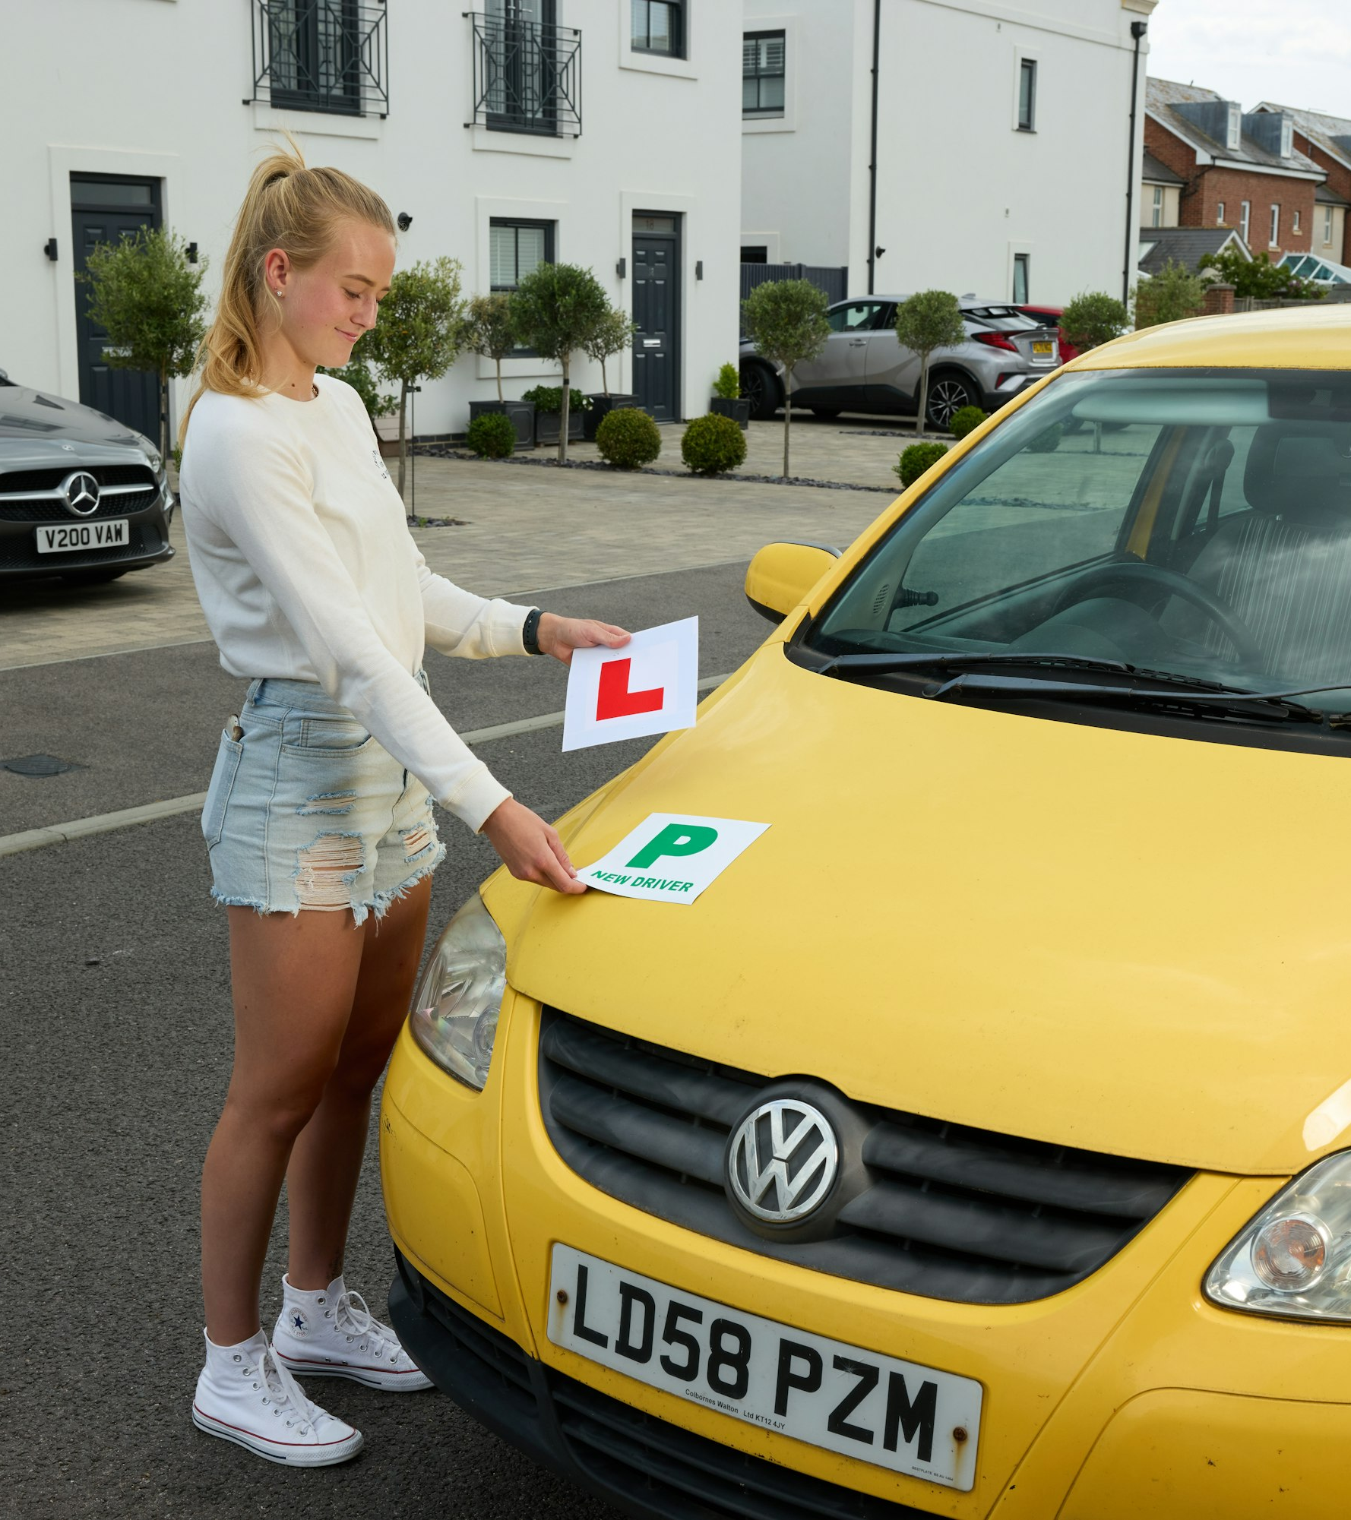

take-away facts
Learning how to assess and manage risk is a part of growing up and becoming an adult.
Hazard perception is a skill that builds over time with experience and there is no limit to how skilled we can become at it.
Think in advance about how you can develop ways to keep yourself and others safer when learning to drive or being a passenger, and how you can encourage others to do the same.

Slide 14

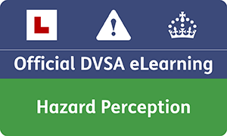
find out more
The DVSA's Ready to Pass campaign helps new drivers prepare effectively for their driving test. It offers resources and tips to ensure you're well-prepared, promoting safe driving habits and boosting your confidence. The goal is to improve your readiness and increase your chances of passing the driving test.
The Official DVSA Guide to Hazard Perception includes 130 video clips to help new drivers recognise and respond to road hazards effectively. This resource provides expert advice and practice scenarios, enhancing your hazard perception skills to improve driving safety and test success.
readytopass.campaign.gov.uk
safedrivingforlife.info/shop/official-dvsa-guide-hazard-perception-elearning

