Slide 1

Lesson #2
Vehicle safety & managing distractions.

Slide 2

group agreement
What ground rules or group agreement statements would we like for this lesson?

Slide 3



learning intentions
personal safety
I am learning how to assess and manage risk and personal safety in a wide range of contexts.
when travelling
I am developing strategies to manage personal safety in relation to travel.
vehicle safety
I am learning to recognise how to make informed choices about vehicle safety.

Slide 4



what helps make a car safe to drive?
In your group, discuss what makes a car safe to drive and write/draw your ideas on the paper provided.
Pass your paper to another group, review what they have done and add any new ideas you might have. Repeat this step one more time.
Return sheets to the original group and offer three answers. What themes are emerging?

Slide 5
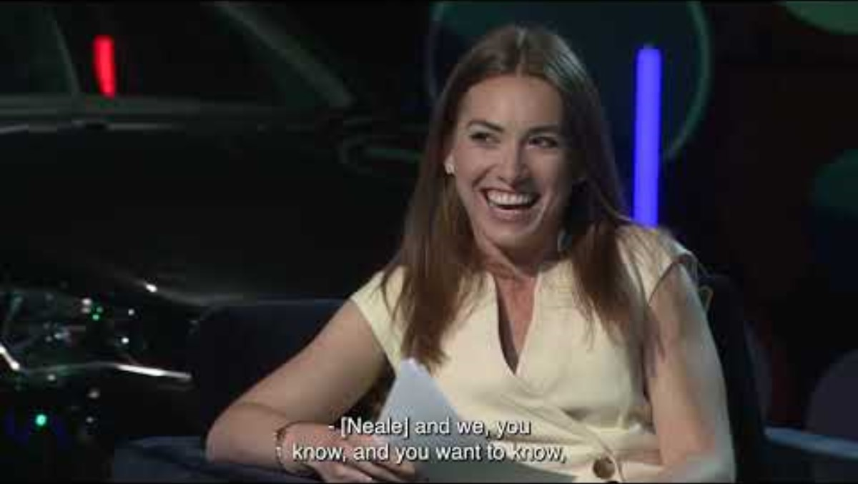
vehicle safety
https://www.youtube.com/watch?v=rKvRZd0P2HI&t=1s

Slide 6
OPTION 1
CREATE A SHORT QUIZ
In groups, create a short quiz for other students in the class about what you have seen and heard in the video.
Example quiz question: What is the preferred age of a car that is suitable for new drivers to drive because it will have better safety features?
Answer: less than 6 years old
Pass the quizzes round to other groups for them to complete.
What questions did you find easiest/most difficult to answer?
01

Slide 7
OPTION 2
FIVE-STAR HUMANS
In small groups, emulate the five-star rating system about car safety and apply to humans:
What are the five markers of a safer driver?
How can drivers set themselves and others up for success in advance and in the moment?
02

Slide 8

what helps make a car safe to drive?
In groups, return to your paper from the beginning of the session. Can you add any more ideas?

Slide 9

learning intentions
personal safety
I am learning how to assess and manage risk and personal safety in a wide range of contexts.
when travelling
Have these been met?
Next steps - what would you like to develop or learn about in the future?
I am developing strategies to manage personal safety in relation to travel.
vehicle safety
I am learning to recognise how to make informed choices about vehicle safety.

Slide 10
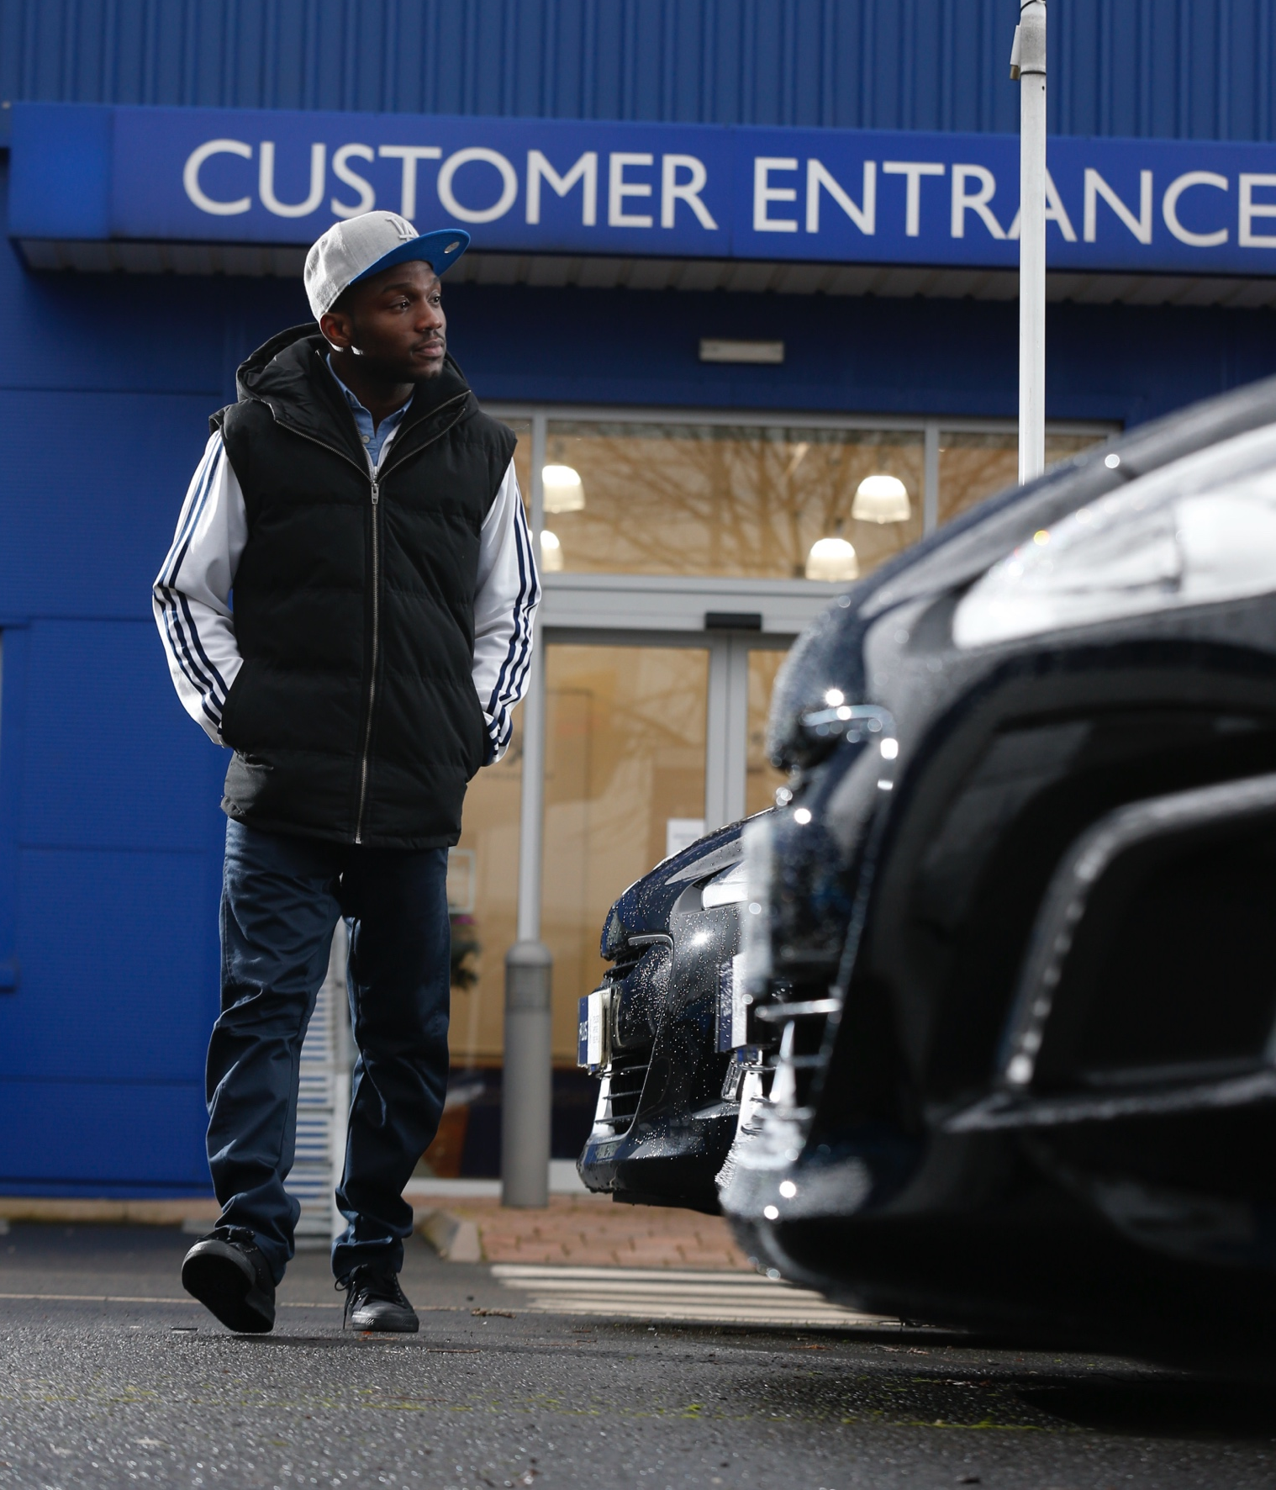

take-away facts
Learning how to assess and manage risk is a part of growing up and becoming an adult.
Choose the safest vehicle that you can within your budget as well as optimal driving conditions to promote and protect safety.
Think in advance about how you can develop ways to keep yourself and others safer when learning to drive or being a passenger, and how you can encourage others to do the same.

Slide 11


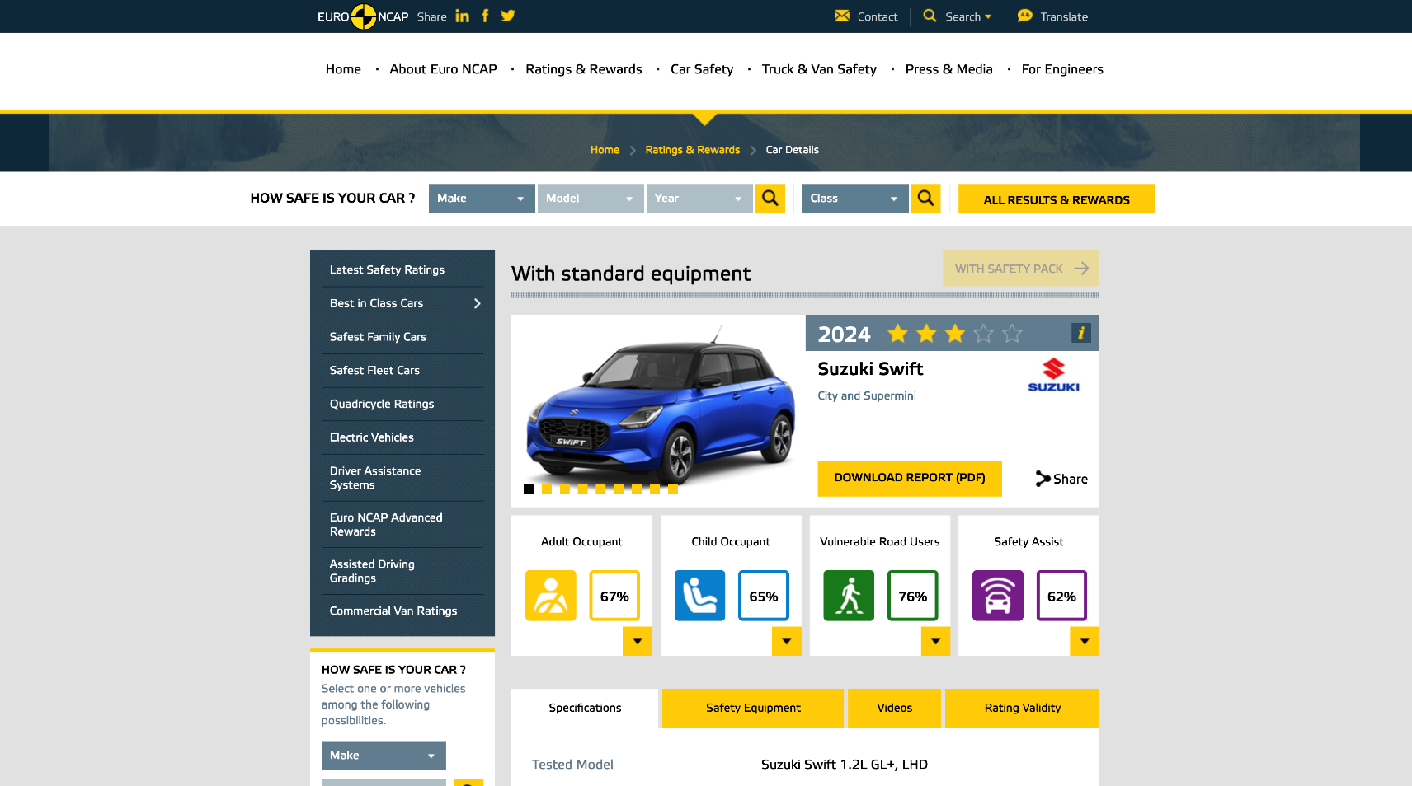
find out more
The EuroNCAP website provides details of how cars have performed in laboratory safety tests, which can be used to inform purchasing decisions.
euroncap.com

