Slide 1
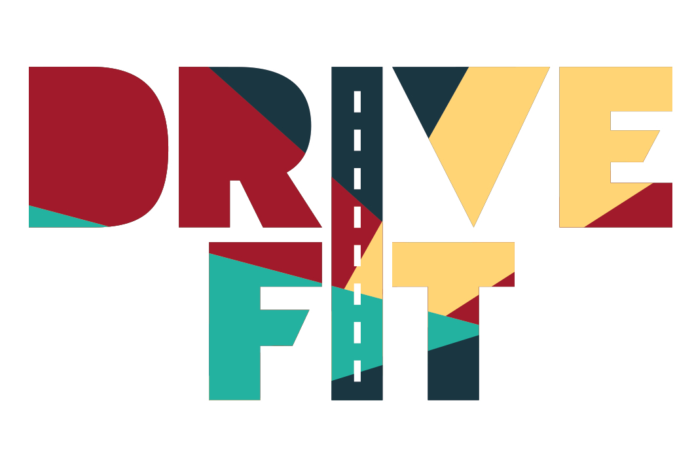
Lesson #3
Managing fatigue and speed.

Slide 2

group agreement
What ground rules or group agreement statements would we like for this lesson?

Slide 3



learning intentions
personal safety
I am learning how to assess and manage risk and personal safety in a wide range of contexts.
when travelling
I am developing strategies to manage personal safety in relation to travel.
vehicle safety
I am learning to recognise how to make informed choices about safer conditions for driving.

Slide 4
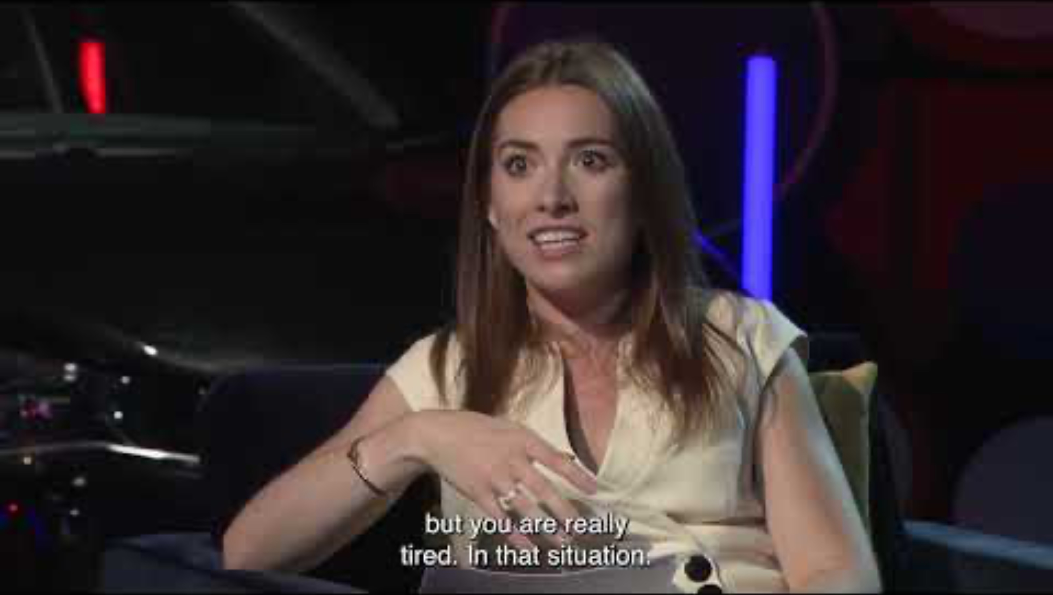
manging fatigue
https://www.youtube.com/watch?v=rGRMmTVky4c

Slide 5


key points from the video
What information have you gleaned from the video?
What are the top take-away tops that have been shared in the video from this and previous lessons?

Slide 6
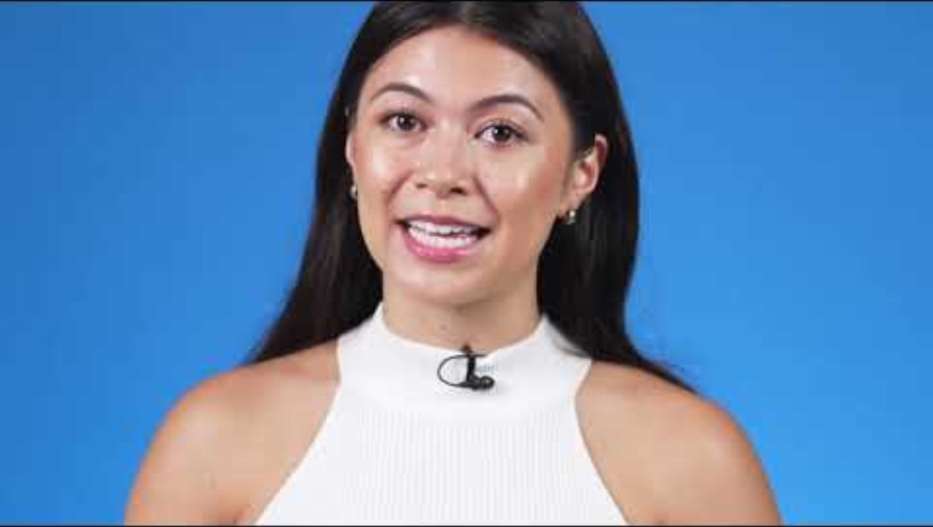
developing if-then plans

Slide 7

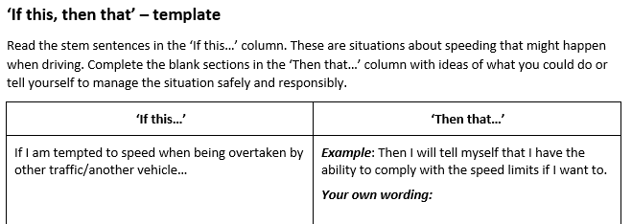
if this, then that activity
Individually, or in pairs complete the ‘if this, then that’ sentence sheet.

Slide 8

solution-focused thinking activity.
In small groups, do some solution-focused thinking in response to these questions:
How can people be encouraged to overcome any barriers they feel about being a safer driver?
How can better habits be encouraged?
How can young people (and young drivers) be a collective force for good?
How can society support people to make safer choices?

Slide 9

driving pledge activity
What is your
driving pledge?

Slide 10

reflection activity
How can use your knowledge of yourself to become the safest driver and/or passenger possible?

Slide 11

learning intentions
personal safety
I am learning how to assess and manage risk and personal safety in a wide range of contexts.
when travelling
Have these been met?
Next steps - what would you like to develop or learn about in the future?
I am developing strategies to manage personal safety in relation to travel.
vehicle safety
I am learning to recognise how to make informed choices about safer conditions for driving.

Slide 12
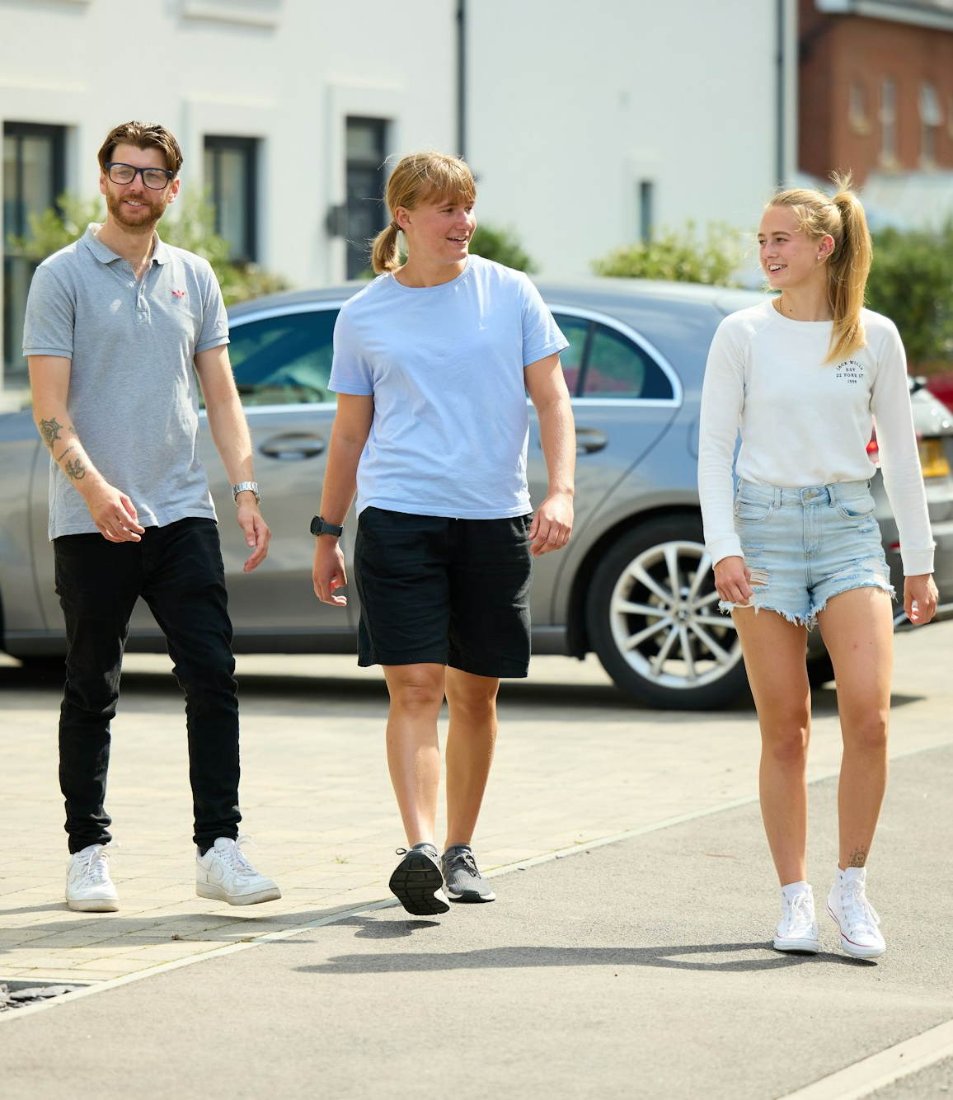

take-away facts
Recognising the importance of being prepared & informed in advance ensures the best possible opportunity for safety while driving.
Learning how to assess and manage risk is a part of growing up and becoming an adult – as is the ability to judge situations and make safe decisions based on knowledge and skills.
Like driving, learning good judgement and discernment skills takes time and practice, and it is all part of building up skills for life.

Slide 13
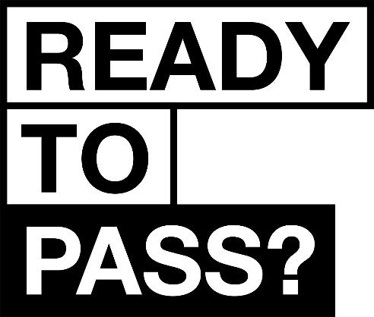

find out more
The DVSA's Ready to Pass campaign helps new drivers prepare effectively for their driving test. It offers resources and tips to ensure you're well-prepared, promoting safe driving habits and boosting your confidence.
Safe Driving for Life provides comprehensive resources for learning and improving driving skills.
readytopass.campaign.gov.uk
safedrivingforlife.info

